Slide 1

Data Security & Cryptology
Encrypted Messaging System
Presenters: Or Magogi, Liron David, Oriel Gilo, Naor Ohana

Slide 2

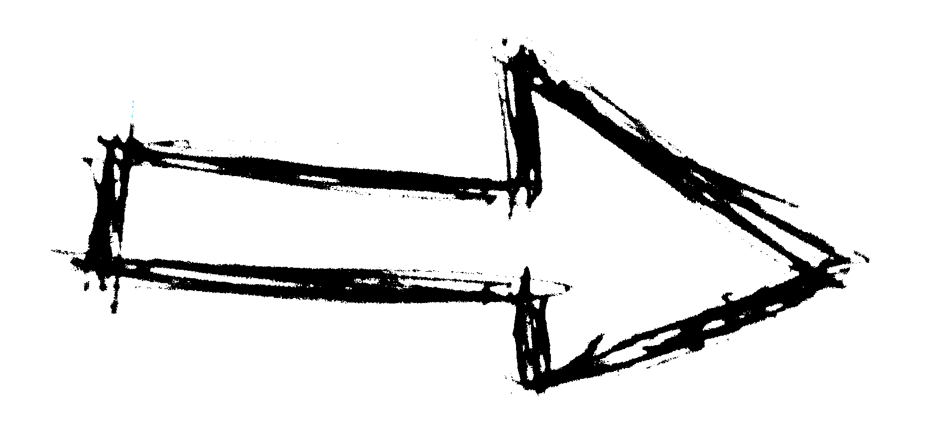
Presentation Flow
How?
Why Encryption?
The Application
Cryptographic
System
Summing Up

Slide 3


How?
Android Studio Firebase

Slide 4
Android Studio
The official IDE (Integrated Development Environment)
for Android development
Works with Java / Kotlin

Slide 5
Firebase
BaaS (Backend as a Service)
Provides:
Authentication
Realtime database
Cloud storage
Cloud messaging

Slide 6

Why Encryption?
Protect personal information
Prevent impersonating
תמונה זו מאת מחבר לא ידוע ניתן ברשיון במסגרת CC BY

Slide 7
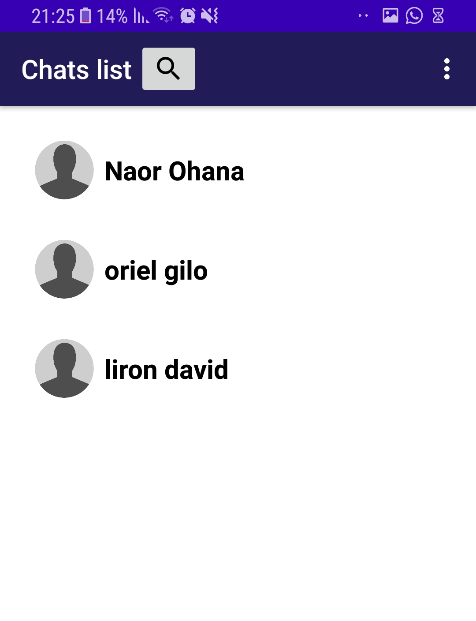
The Application
Register and login
Search users
Active chats appear

Slide 8
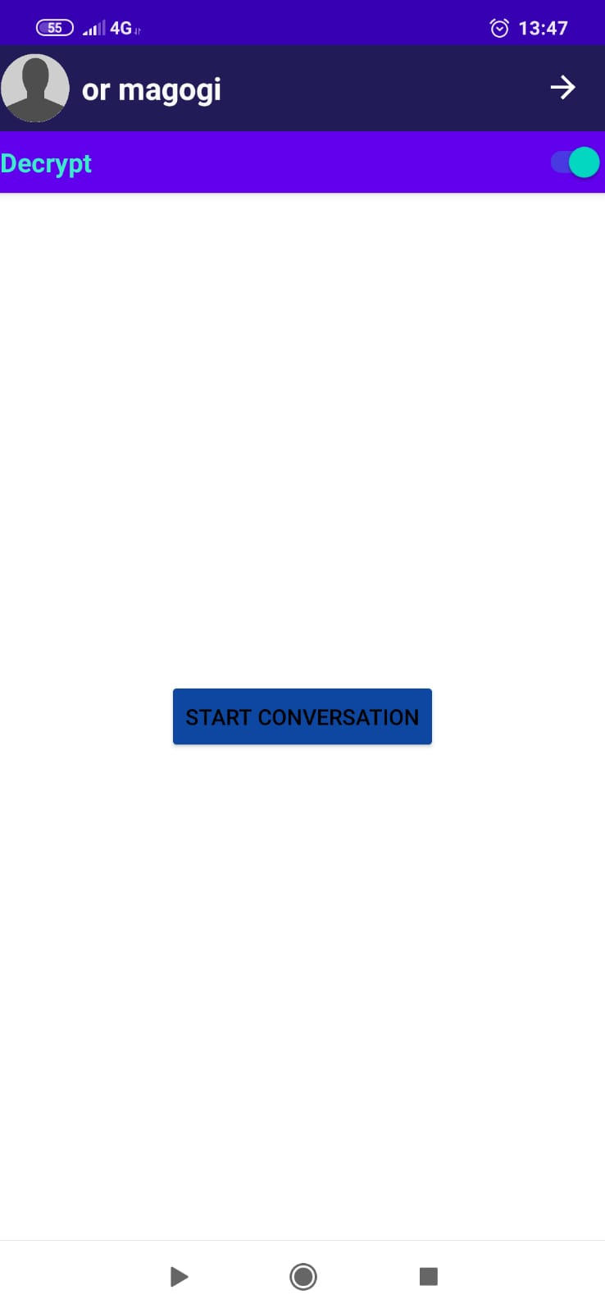
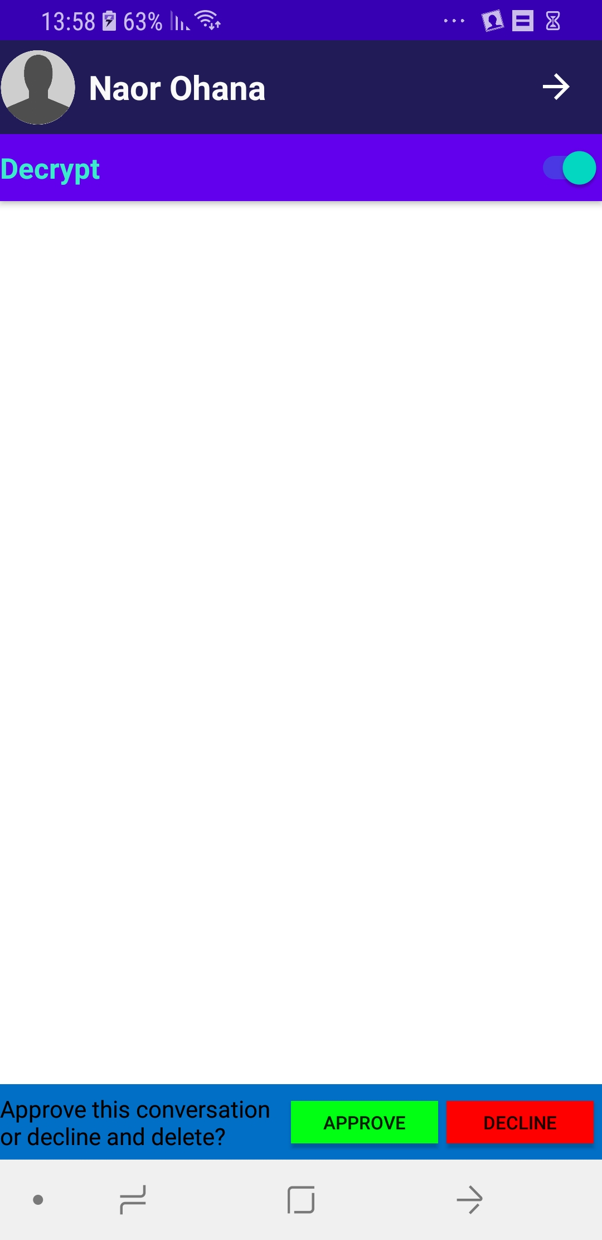
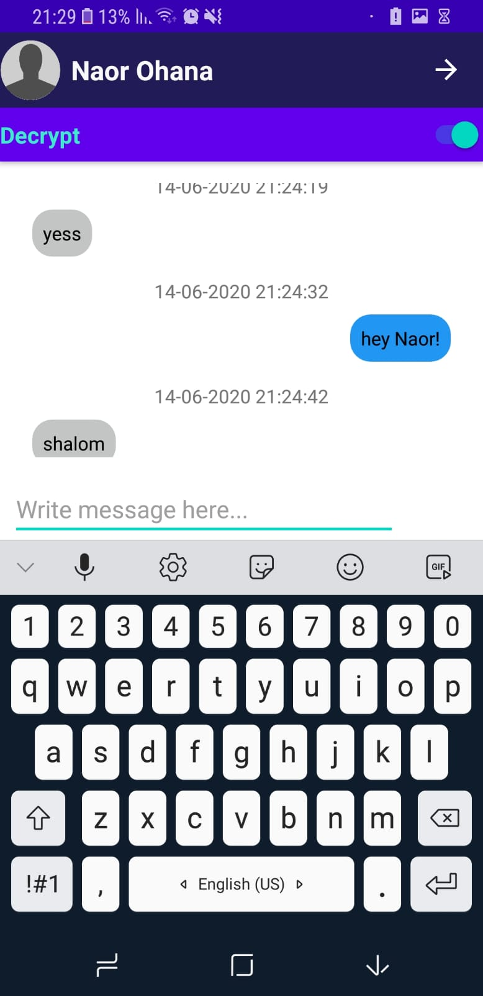

Slide 9
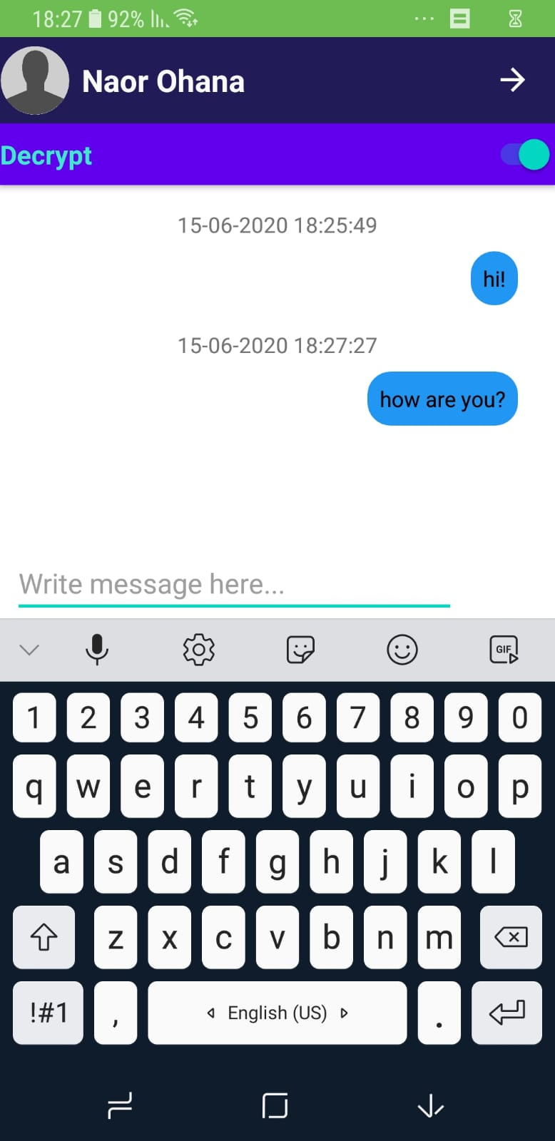
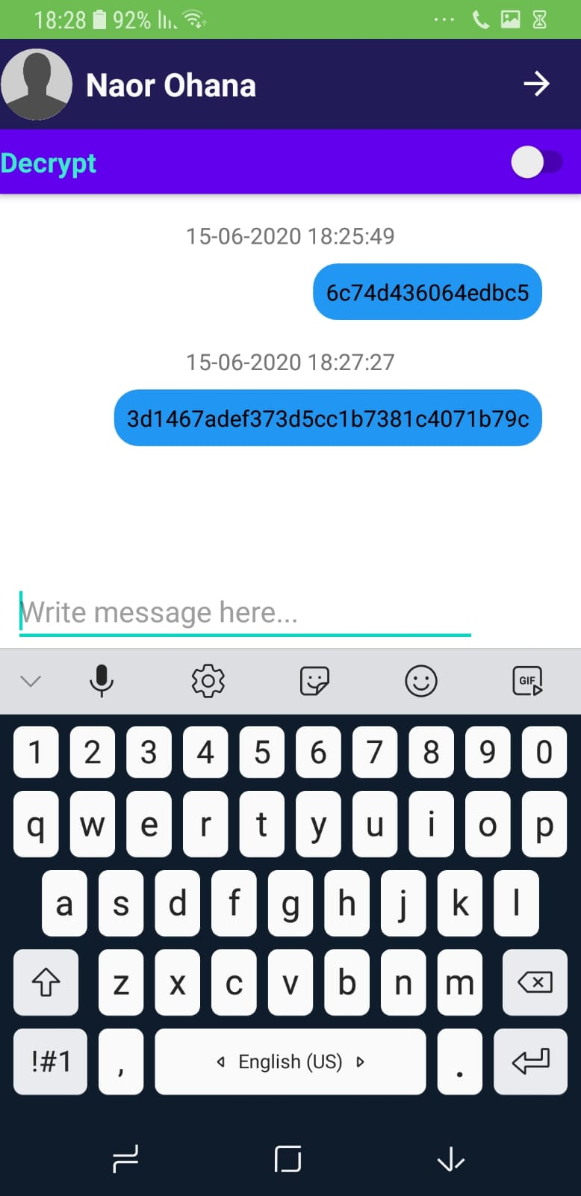

Slide 10


Cryptographic System
Triple-DES (Data Encryption Standard) with CBC chaining mode
RSA
Digital Signature

Slide 11
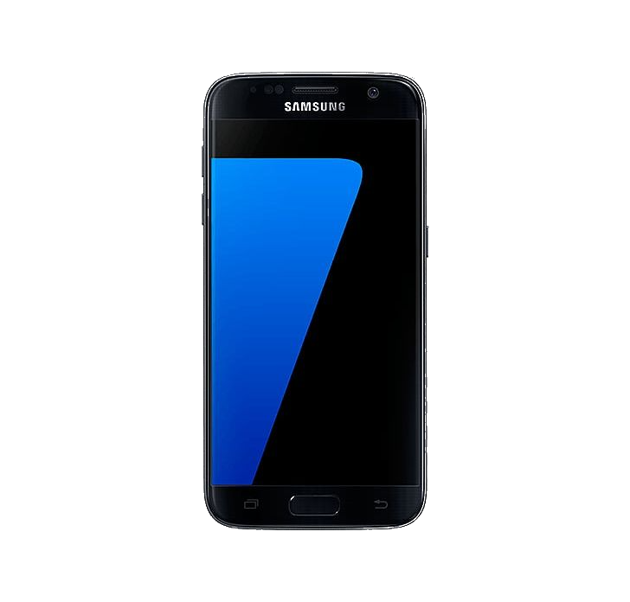
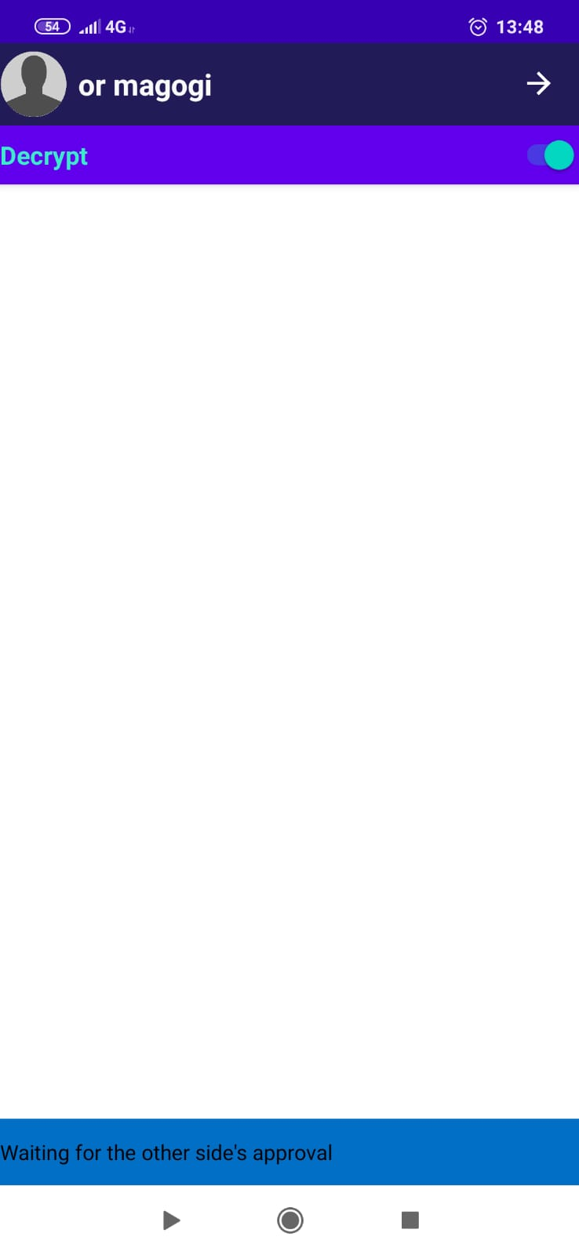

Sender: Start conversation
Sender: listen for approval
createKeys()
generateKey()
symmetricKey,foreignPublicKey
foreignPublicKey,
newChatRequest
RSA
Key
Generator
newChatRequest
publicKey,
KIC
publicKey,
newChatRequest
foreignPublicKey,
KIC
RSA
privateKey,
publicKey,
chatID
KIC
decrypt(KIC,privateKey)
RSA
RSA
createKeys()
Delete conversation
symmetricKey
full chat details:chatId, foreignPublicKey,privateKey,PublicKey,symmetricKey
Approved?
Save chat details to local DB
Declined
Approved
Receiver: Approve/decline conversation
Save chat details to local DB
Update local DB(full chat details)
Delete keys

Slide 12
The message is shown-
If it is valid
symmetricKey(k1,k2,k3,IV)
A text message is sent
M
TDES
C
C+S
C+S
C
TDES
M
Hash
function
KA1
S
S
valid/not valid
Hash
function
RSA
RSA
KA2

Slide 13
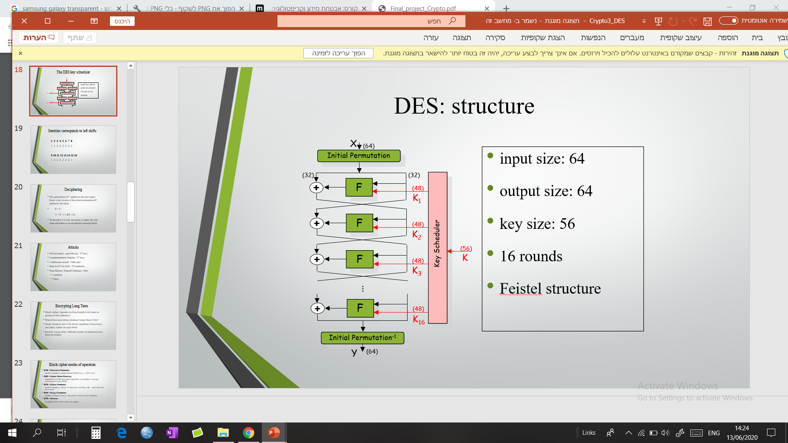
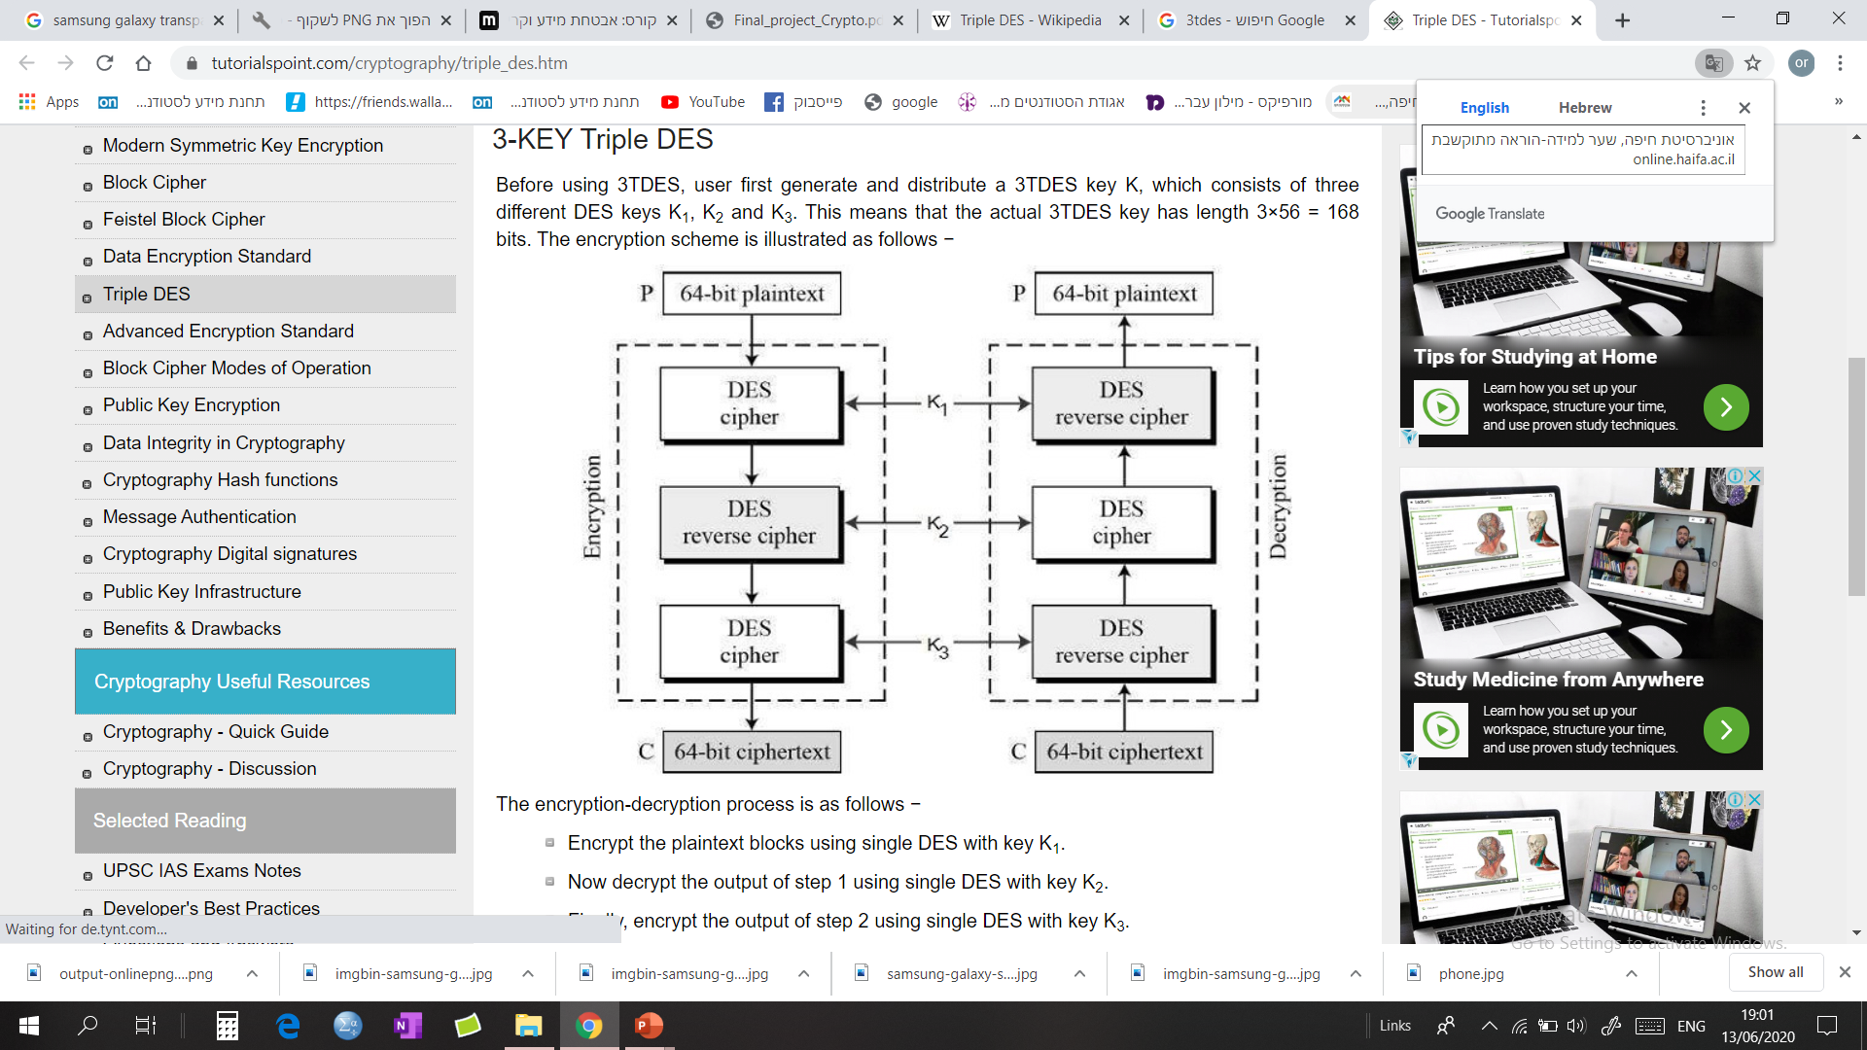
Triple DES
Key1, key2,key3 – 64 bit
PlainText – 64 bit
C= Ek3 (Dk2 (Ek1))

Slide 14
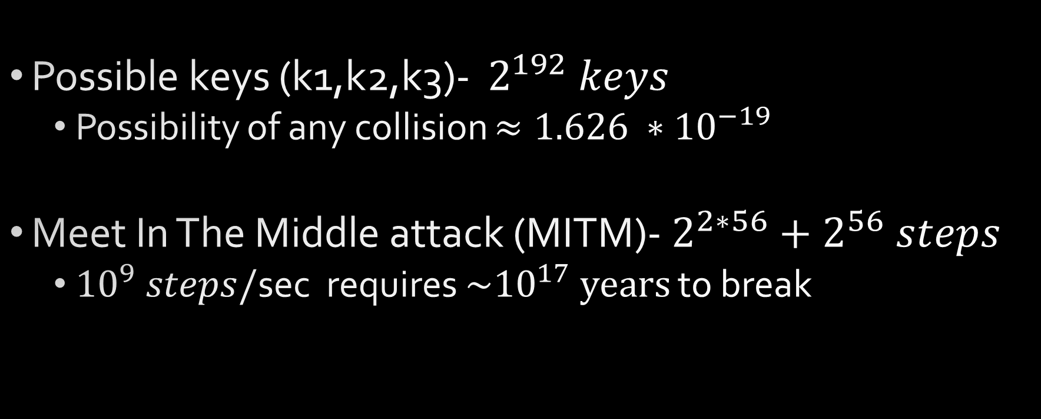
Triple DES – strength
Possible keys (k1,k2,k3)- $2^{192} keys$
Possibility of any collision $≈1.626 ∗{10}^{−19}$
Meet In The Middle attack (MITM)- $2^{2∗56}+2^{56} steps$
${10}^{9} steps/$sec requires $\sim {10}^{17} years$ to break

Slide 15
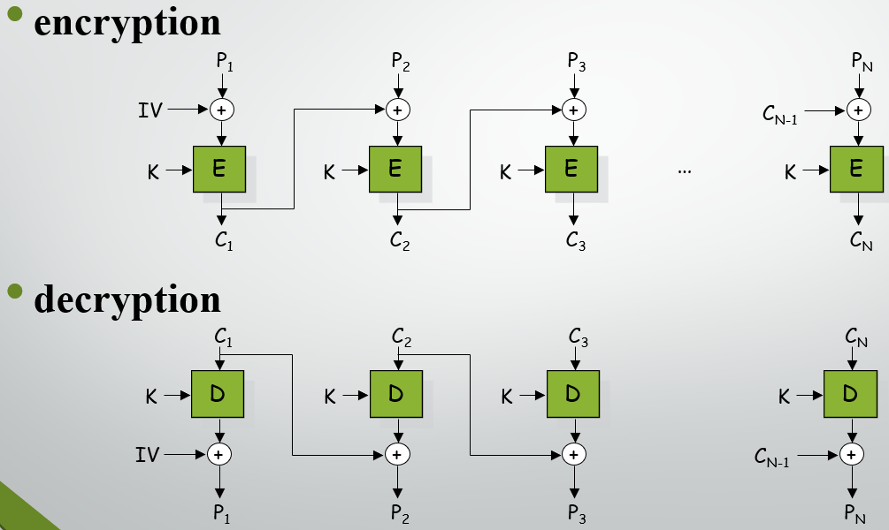
CBC mode
“ Cryptology course presentation”
IV – 64bit
Pi - 64 bit
“e presen”
“gy cours”
“tation ”
“ Cryptolo”

Slide 16





RSA
Key setup:
Generate p, q. calculate n=p*q
Choose e ( gcd( e,φ(n) )=1 , 1<e< φ(n) )
Calculate d, by solving: e*d $≡$ 1 mod φ(n)
PublicKey = $\left\{e,n\right\}$
PrivateKey = $\left\{d,p,q\right\}$
The algorithm:
Encryption: $C=M^{e}mod n$
Decryption: $M=C^{d}mod n$

Slide 17
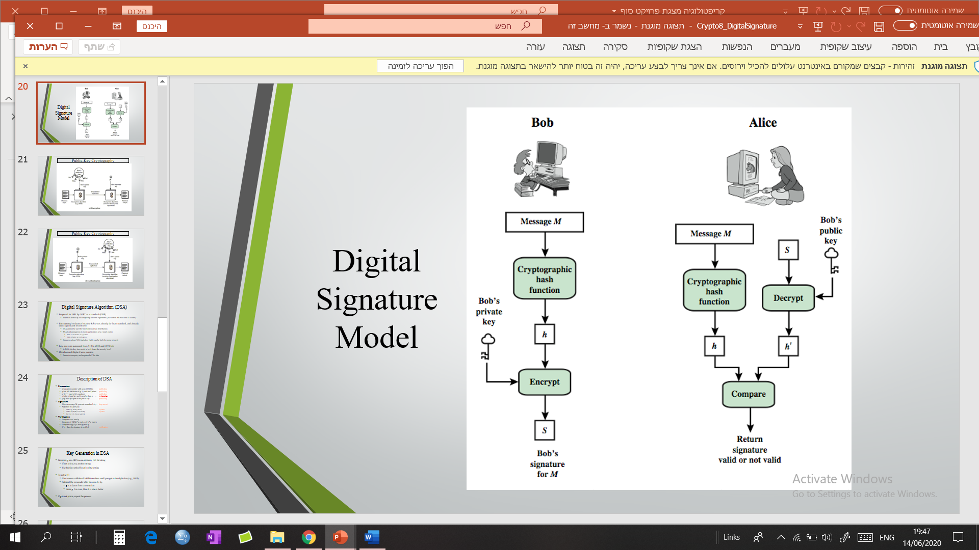
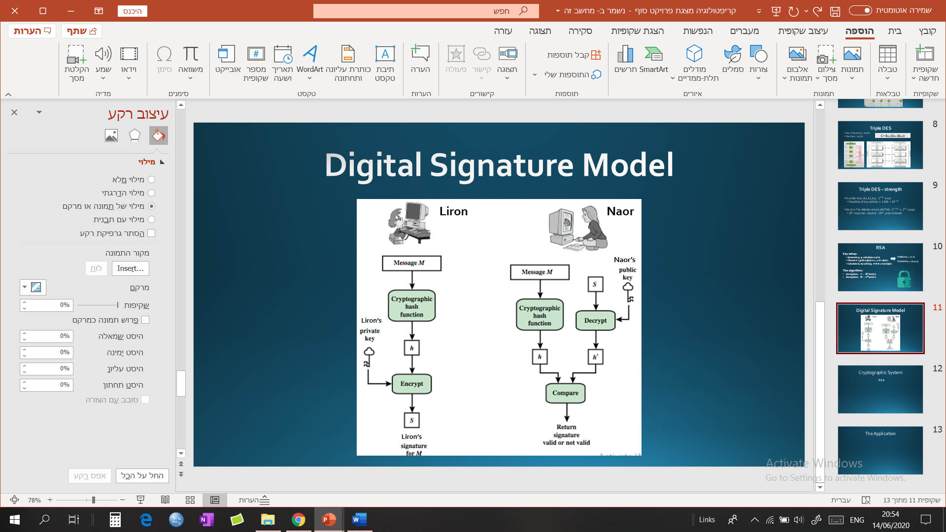
Digital Signature Model
Liron
Naor
Naor’s
Liron’s
Liron’s

Slide 18
Summing Up
Safe messaging platform-
3-keys Triple DES
RSA
Digital signature
d

Slide 19










































$$T$$
h
$$a$$
$$n$$
$$k$$
$$Y$$
$$o$$
$$u$$
$$54$$
$$68$$
$$61$$
$$6E$$
$$6B$$
$$59$$
$$6F$$
$$75$$
$$F$$
$$o$$
$$r$$
$$L$$
$$i$$
$$s$$
$$t$$
$$e$$
$$n$$
$$i$$
$$n$$
$$g$$
$$!$$
$46$
$6F$
$72$
$$4C$$
$69$
$73$
$74$
$65$
$6E$
$69$
$6E$
$67$
$$21$$

